Slide 1
Chapter 1: Introduction CSCI 410 Operating Systems

Slide 2
Chapter 1: Introduction to Course
What Operating Systems Do
Computer-System Organization
Computer-System Architecture
Operating-System Structure
Operating-System Operations
Process Management
Memory Management
Storage Management
Protection and Security
Distributed Systems
Special-Purpose Systems
Computing Environments
Open-Source Operating Systems

Slide 3
Chapter Objectives
To provide a grand tour of the major operating systems components
Chapter 1 is broad coverage but shallow
To provide coverage of basic computer system organization

Slide 4
What is an Operating System?
A program that acts as an intermediary between a user of a computer and the computer hardware
Operating system goals:
Execute user programs (Safely!)
Make the computer system convenient to use
Use the computer hardware in an efficient manner

Slide 5
Computer System Structure
Computer system can be divided into four components:
Hardware – provides basic computing resources
CPU, memory, I/O devices
Operating system
Controls and coordinates use of hardware among various applications and users
Application programs – Software to solve computing problems of users
Word processors, compilers, web browsers, database systems, video games
Users
People, machines, other computers

Slide 6
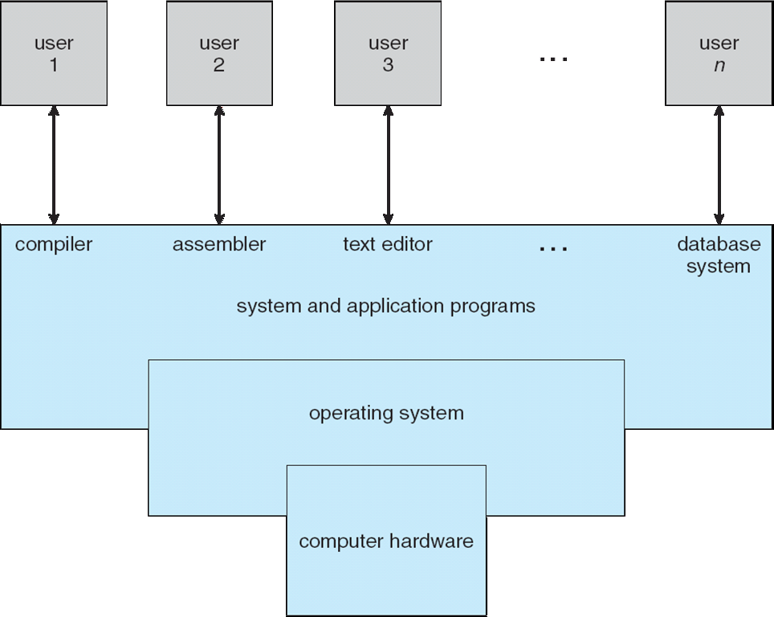
Four Components of a Computer System

Slide 7
What Operating Systems Do
Depends on point of view
Users want convenience, ease of use
Don’t care about resource utilization
Shared computers such as mainframe or minicomputer must keep all users happy
Users of dedicate systems such as workstations have dedicated resources
Still share among processes
Handheld computers are resource poor, optimized for usability and battery life
Some computers have little or no user interface, such as embedded computers in devices and automobiles

Slide 8
Operating System Definition
OS is a resource allocator
Manages all resources
Decides between conflicting requests for efficient and fair resource use
OS is a control program
Controls execution of programs to prevent errors and improper use of the computer

Slide 9
Operating System Definition (Cont.)
No universally accepted definition
“Everything a vendor ships when you order an operating system” is good approximation
But varies wildly
“The one program running at all times on the computer” is the kernel. Everything else is either a system program (ships with the operating system) or an application program.

Slide 10
Computer Startup
bootstrap program is loaded at power-up or reboot
Typically stored in ROM or EPROM, generally known as firmware
Initializes all aspects of system
Loads operating system kernel and starts execution

Slide 11
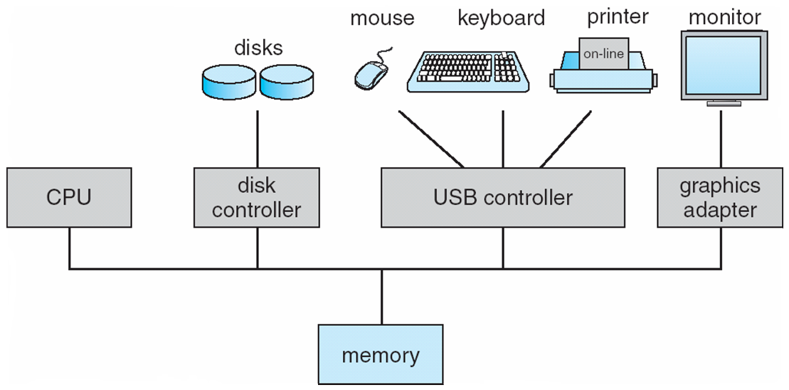
Computer System Organization
Computer-system operation
One or more CPUs, device controllers connect through common bus providing access to shared memory
Concurrent execution of CPUs and devices competing for memory cycles

Slide 12
Computer-System Operation
I/O devices and the CPU can execute concurrently
Each device controller is in charge of a particular device type
Each device controller has a local buffer (RAM)
CPU moves data from/to main memory to/from local buffers
I/O is from the device to local buffer of a controller
Device controller informs CPU that it has finished its operation by causing an interrupt

Slide 13
Common Functions of Interrupts
Interrupt transfers control to the interrupt service routine generally, through the interrupt vector, which contains the addresses of all the service routines
Interrupt architecture must save the address of the interrupted instruction
Incoming interrupts are disabled while another interrupt is being processed to prevent a lost interrupt
A trap is a software-generated interrupt caused either by an error or a user request
An operating system is interrupt driven

Slide 14
Interrupt Handling
The operating system preserves the state of the CPU by storing registers and the program counter
Determines which type of interrupt has occurred:
polling
vectored interrupt system
Separate segments of code determine what action should be taken for each type of interrupt

Slide 15
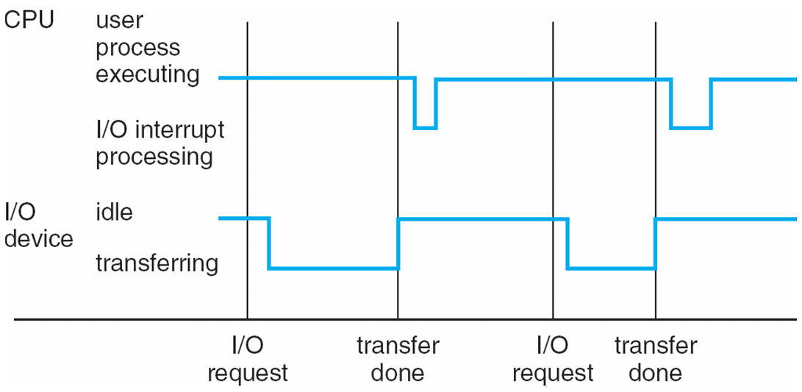
Interrupt Timeline

Slide 16
I/O Structure Types
After I/O starts, control returns to user program only upon I/O completion
Wait instruction idles the CPU until the next interrupt
Wait loop (contention for memory access)
At most one I/O request is outstanding at a time, no simultaneous I/O processing
After I/O starts, control returns to user program without waiting for I/O completion
System call – request to the operating system to allow user to wait for I/O completion
Device-status table contains entry for each I/O device indicating its type, address, and state
Operating system indexes into I/O device table to determine device status and to modify table entry to include interrupt

Slide 17
Direct Memory Access Structure
Used for high-speed I/O devices able to transmit information at close to memory speeds
Device controller transfers blocks of data from buffer storage directly to main memory without CPU intervention
Only one interrupt is generated per block, rather than the one interrupt per byte

Slide 18
Notation Review
Computer storage, along with most computer throughput, is generally measured and manipulated in bytes and collections of bytes.
bit is a 0/1; byte is 8 bits (nibble is 4 bits!)
Word depends on CPU register size (native data unit size)
16 bit, 32 bit, 64, bit
kilobyte, or KB, is 1,024 bytes
megabyte, or MB, is 1,024² bytes
gigabyte, or GB, is 1,024³ bytes
terabyte, or TB, is 1,024⁴ bytes
petabyte, or PB, is 1,024⁵ bytes
exabyte, EB, is 1,024⁶ bytes (zeta, yota, xenotta, Shilentno, domegemegrotte) (Internet traffic will reach 1.3 ZB in 2016)
NOTE: Network throughput is usually measured in powers of 10.
10mbps is 10,000,000 bits per second

Slide 19
Storage Structure
Main memory – only large storage media that the CPU can access directly
Random access
Typically volatile
Secondary storage – extension of main memory that provides large nonvolatile storage capacity
Hard disks – rigid metal or glass platters covered with magnetic recording material
Disk surface is logically divided into tracks, which are subdivided into sectors
The disk controller determines the logical interaction between the device and the computer
Solid-state disks – faster than hard disks, nonvolatile
Various technologies
Becoming more popular

Slide 20
Storage Hierarchy
Storage systems organized in hierarchy
Speed
Cost
Volatility
Caching – copying information into faster storage system; main memory can be viewed as a cache for secondary storage

Slide 21
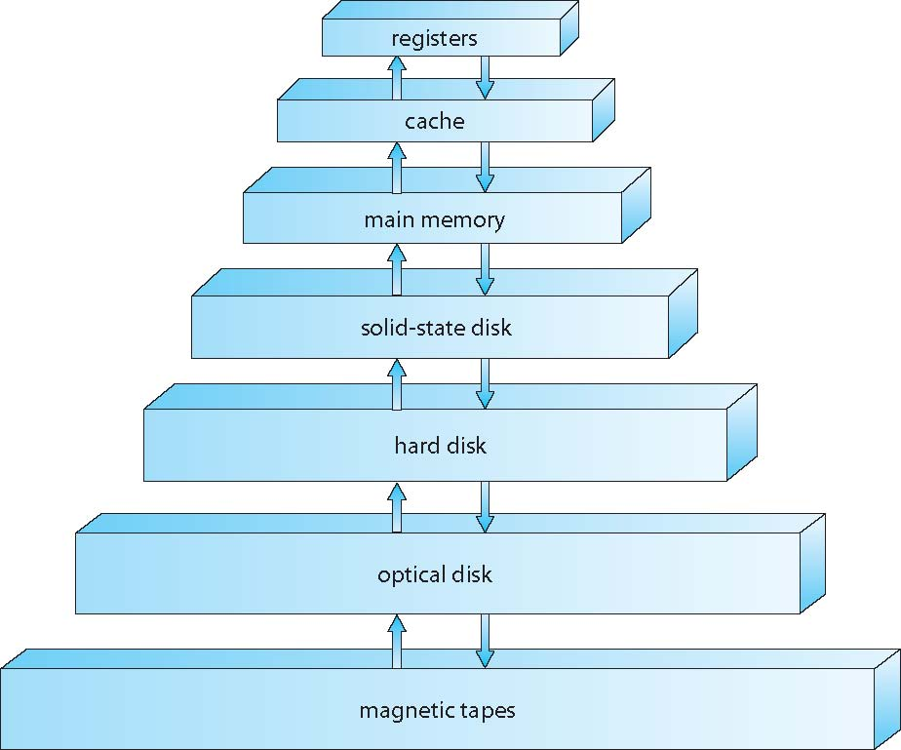
Storage-Device Hierarchy

Slide 22
Sample Speeds
Writes are expensive!
Datastore is transactional: writes require disk access
Disk access means disk seeks
Rule of thumb: 10ms for a disk seek
Simple math: 1s / 10ms = 100 seeks/sec maximum
Reads are cheap!
Reads do not need to be transactional, just consistent
Data is read from disk once, then it's easily cached
All subsequent reads come straight from memory
Rule of thumb: 250usec for 1MB of data from memory
Simple math: 1s / 250usec = 4GB/sec maximum * For a 1MB entity, that's 4000 fetches/sec

Slide 23
Sample Speeds
L1 cache reference 0.5 ns
Branch mispredict 5 ns
L2 cache reference 7 ns
Mutex lock/unlock 100 ns
Main memory reference 100 ns
Compress 1K bytes with Zippy 10,000 ns
Send 2K bytes over 1 Gbps network 20,000 ns
Read 1 MB sequentially from memory 250,000 ns
Round trip within same datacenter 500,000 ns
Disk seek 10,000,000 ns
Read 1 MB sequentially from network 10,000,000 ns
Read 1 MB sequentially from disk 30,000,000 ns
Send packet CA->Netherlands->CA 150,000,000 ns

Slide 24
Caching
Important principle, performed at many levels in a computer (in hardware, operating system, software)
Data in use copied from slower to faster storage temporarily
Faster storage (cache) checked first to determine if data is there
If it is, data used directly from the cache (fast)
If not, data copied to cache and used there
Cache smaller than storage being cached
Cache management important design problem
Cache size and replacement policy

Slide 25
Computer-System Architecture
In the past systems used a single general-purpose (GP) processor
Most systems have special-purpose processors as well
Today many (most?) have multiple GP cores/processors
Multiprocessor systems becoming common
Also known as parallel systems, tightly-coupled systems
Advantages include:
Increased throughput
Economy of scale
Increased reliability – graceful degradation or fault tolerance
Two types:
Asymmetric Multiprocessing
Symmetric Multiprocessing

Slide 26
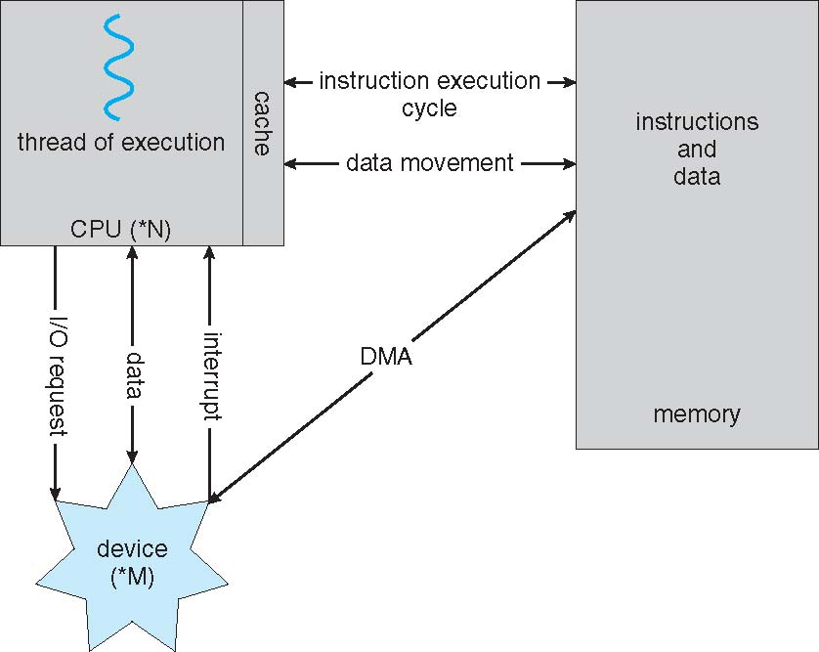
How a Modern Computer Works
A von Neumann architecture

Slide 27
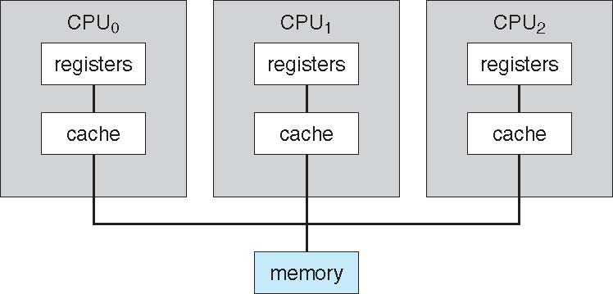
Symmetric Multiprocessing Architecture

Slide 28
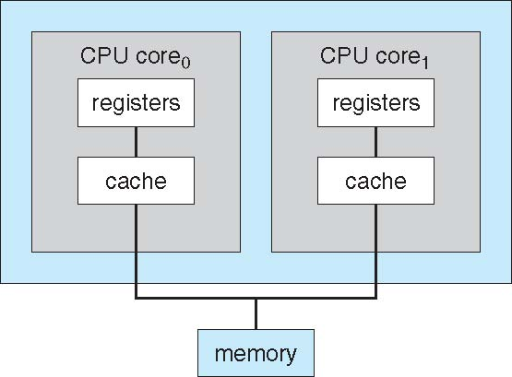
A Dual-Core Design

Slide 29
Clustered Systems
Like multiprocessor systems, but multiple systems working together
Usually sharing storage via a storage-area network (SAN)
Provides a high-availability service which survives failures
Asymmetric clustering has one machine in hot-standby mode
Symmetric clustering has multiple nodes running applications, monitoring each other
Some clusters are for high-performance computing (HPC)
Applications must be written to use parallelization

Slide 30
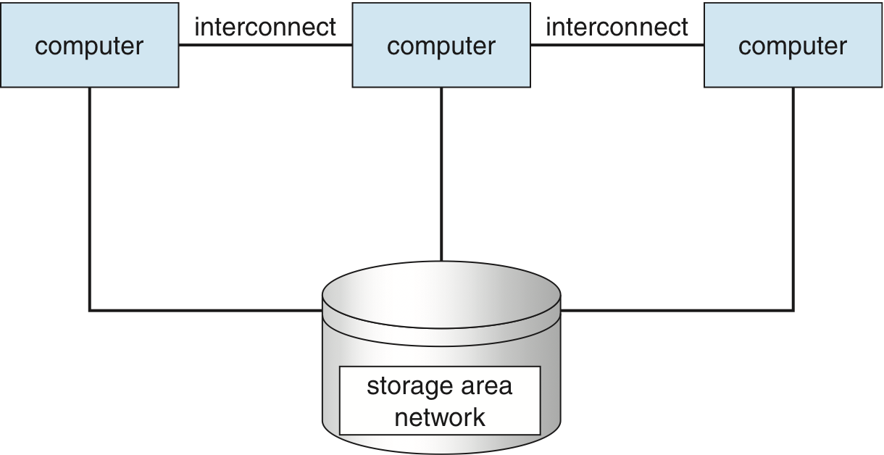
Clustered Systems

Slide 31
Operating System Structure
Multiprogramming needed for efficiency
Single user cannot keep CPU and I/O devices busy at all times
Multiprogramming organizes jobs (code and data) so CPU always has one to execute
A subset of total jobs in system is kept in memory
One job selected and run via job scheduling
When it has to wait (for I/O for example), OS switches to another job
Timesharing (multitasking) is logical extension in which CPU switches jobs so frequently that users can interact with each job while it is running, creating interactive computing
Response time should be < 1 second
Each user has at least one program executing in memory process
If several jobs ready to run at the same time  CPU scheduling
If processes don’t fit in memory, swapping moves them in and out to run
Virtual memory allows execution of processes not completely in memory

Slide 32
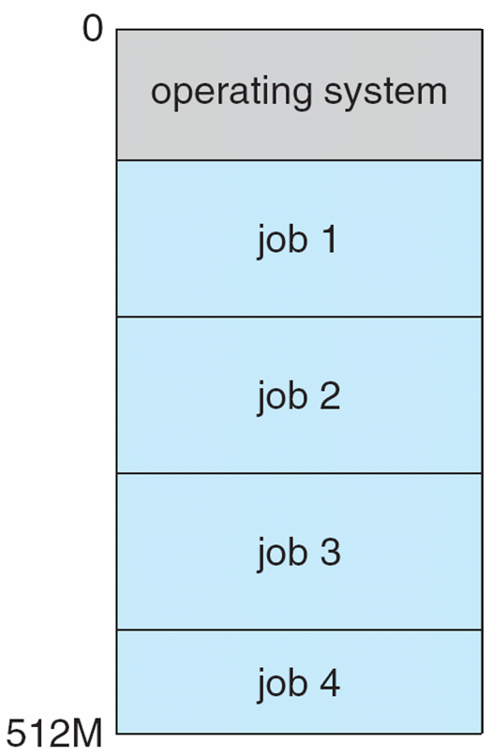
Memory Layout for Multiprogrammed System

Slide 33
Operating-System Operations
Interrupt driven by hardware
Software error or request creates exception or trap
Division by zero, request for operating system service
Other process problems include infinite loop, processes modifying each other or the operating system
Dual-mode operation allows OS to protect itself and other system components
User mode and kernel mode (AKA: supervisor mode – protected vs real)
Mode bit provided by hardware
Provides ability to distinguish when system is running user code or kernel code
Some instructions designated as privileged, only executable in kernel mode
System call changes mode to kernel, return from call resets it to user

Slide 34
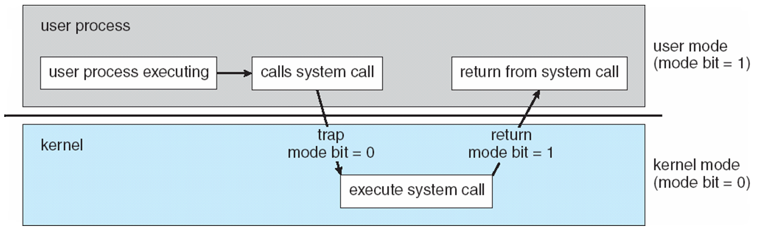
Transition from User to Kernel Mode
Timer to prevent infinite loop / process hogging resources
Set interrupt after specific period
Operating system decrements counter
When counter zero generate an interrupt
Set up before scheduling process to regain control or terminate program that exceeds allotted time

Slide 35
Process Management
A process is a program in execution. It is a unit of work within the system. Program is a passive entity, process is an active entity.
Process needs resources to accomplish its task
CPU, memory, I/O, files
Initialization data
Process termination requires reclaim of any reusable resources
Single-threaded process has one program counter specifying location of next instruction to execute
Process executes instructions sequentially, one at a time, until completion
Multi-threaded process has one program counter per thread
Typically system has many processes, some user, some operating system running concurrently on one or more CPUs
Concurrency by multiplexing the CPUs among the processes / threads

Slide 36
Process Management Activities
The operating system is responsible for the following activities in connection with process management:
Creating and deleting both user and system processes
Suspending and resuming processes
Providing mechanisms for process synchronization
Providing mechanisms for process communication
Providing mechanisms for deadlock handling

Slide 37
Memory Management
All data in memory before and after processing
All instructions in memory in order to execute
Memory management determines what is in memory when
Optimizing CPU utilization and computer response to users
Memory management activities
Keeping track of which parts of memory are currently being used and by whom
Deciding which processes (or parts thereof) and data to move into and out of memory
Allocating and deallocating memory space as needed

Slide 38
Storage Management
OS provides uniform, logical view of information storage
Abstracts physical properties to logical storage unit - file
Each medium is controlled by device (i.e., disk drive, tape drive)
Varying properties include access speed, capacity, data-transfer rate, access method (sequential or random)
File-System management
Files usually organized into directories
Access control on most systems to determine who can access what
OS activities include
Creating and deleting files and directories
Primitives to manipulate files and dirs
Mapping files onto secondary storage
Backup files onto stable (non-volatile) storage media

Slide 39
Mass-Storage Management
Usually disks used to store data that does not fit in main memory or data that must be kept for a “long” period of time
Proper management is of central importance
Entire speed of computer operation hinges on disk subsystem and its algorithms
OS activities
Free-space management
Storage allocation
Disk scheduling
Some storage need not be fast
Tertiary storage includes optical storage, magnetic tape
Still must be managed – by OS or applications
Varies between WORM (write-once, read-many-times) and RW (read-write)

Slide 40
Performance of Various Levels of Storage
Movement between levels of storage hierarchy can be explicit or implicit

Slide 41
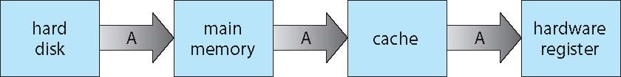
Migration of Integer A from Disk to Register
Multitasking environments must be careful to use most recent value, no matter where it is stored in the storage hierarchy
Multiprocessor environment must provide cache coherency in hardware such that all CPUs have the most recent value in their cache
Distributed environment situation even more complex
Several copies of a datum can exist
Various solutions covered in Chapter 17

Slide 42
Protection and Security
Protection – any mechanism for controlling access of processes or users to resources defined by the OS
Security – defense of the system against internal and external attacks
Huge range, including denial-of-service, worms, viruses, identity theft, theft of service
Systems generally first distinguish among users, to determine who can do what
User identities (user IDs, security IDs) include name and associated number, one per user
User ID then associated with all files, processes of that user to determine access control
Group identifier (group ID) allows set of users to be defined and controls managed, then also associated with each process, file
Privilege escalation allows user to change to effective ID with more rights

Slide 43
Distributed Computing
Collection of separate, possibly heterogeneous, systems networked together
Network is a communications path
Local Area Network (LAN)
Wide Area Network (WAN)
Metropolitan Area Network (MAN)
Network Operating System provides features between systems across network
Communication scheme allows systems to exchange messages
Illusion of a single system

Slide 44
Special-Purpose Systems
Real-time embedded systems most prevalent form of computers
Vary considerable, special purpose, limited purpose OS, real-time OS
Multimedia systems
Streams of data must be delivered according to time restrictions
Handheld systems
PDAs, smart phones, limited CPU, memory, power
Reduced feature set OS, limited I/O

Slide 45
Computing Environments
Traditional computer
Blurring over time
Office environment
PCs connected to a network, terminals attached to mainframe or minicomputers providing batch and timesharing
Now portals allowing networked and remote systems access to same resources
Home networks
Used to be single system, then modems
Now firewalled, networked

Slide 46
Computing Environments (Cont.)
Client-Server Computing
Dumb terminals supplanted by smart PCs
Many systems now servers, responding to requests generated by clients
Compute-server provides an interface to client to request services (i.e., database)
File-server provides interface for clients to store and retrieve files

Slide 47
Peer-to-Peer Computing
Another model of distributed system
P2P does not distinguish clients and servers
Instead all nodes are considered peers
Each may act as client, server or both
Node must join P2P network
Registers its service with central lookup service, or
Broadcast request for service and respond to requests for service via discovery protocol
Examples include Napster, BitTorrent, and Gnutella

Slide 48
Virtualization
Allows operating systems to run applications within other OSes
Vast and growing industry
Emulation used when source CPU type different from target type (i.e. PowerPC to Intel x86)
Generally slowest method
When computer language not compiled to native code – Interpretation
Virtualization – OS natively compiled for CPU, running guest OSes also natively compiled
Consider VMware running WinXP guests, each running applications, all on native WinXP host OS
VMM (virtual machine Manager) provides virtualization services

Slide 49
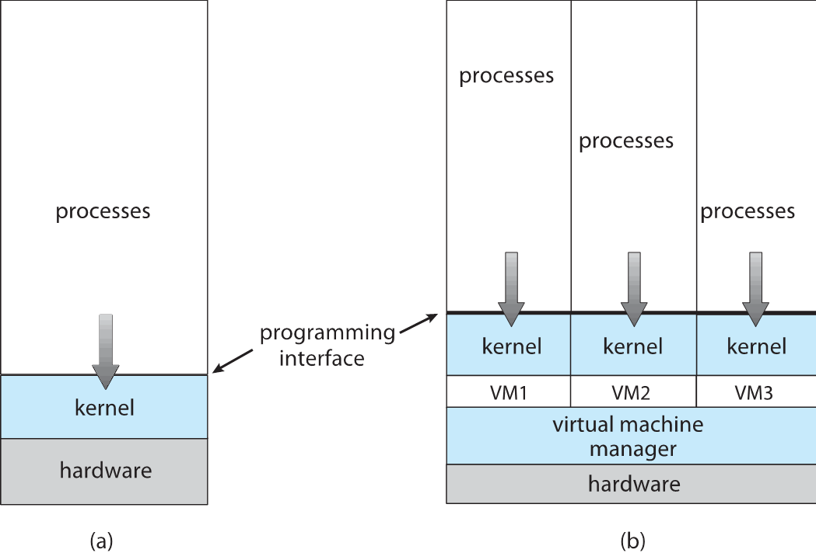
Virtualization

Slide 50
Web-Based Computing
Web has become ubiquitous
PCs most prevalent devices
More devices becoming networked to allow web access
New category of devices to manage web traffic among similar servers: load balancers
Use of operating systems like Windows 95, client-side, have evolved into Linux and Windows XP, which can be clients and servers

Slide 51
Cloud Computing
Delivers computing, storage, even apps as a service across a network
Logical extension of virtualization because it uses virtualization as the base for it functionality.
Amazon EC2 has thousands of servers, millions of virtual machines, petabytes of storage available across the Internet, pay based on usage
Many types
Public cloud – available via Internet to anyone willing to pay
Private cloud – run by a company for the company’s own use
Hybrid cloud – includes both public and private cloud components
Software as a Service (SaaS) – one or more applications available via the Internet (i.e., word processor)
Platform as a Service (PaaS) – software stack ready for application use via the Internet (i.e., a database server)
Infrastructure as a Service (IaaS) – servers or storage available over Internet (i.e., storage available for backup use)

Slide 52
Cloud Computing

Slide 53
Open-Source Operating Systems
Operating systems made available in source-code format rather than just binary closed-source
Counter to the copy protection and Digital Rights Management (DRM) movement
Started by Free Software Foundation (FSF), which has “copyleft” GNU Public License (GPL)
Examples include GNU/Linux, Android, and, BSD UNIX (including core of Mac OS X), and many more

Slide 54
End of Chapter 1 Material Skipped: OS Data Structures (please read this and ask questions if needed.)

